Slide 1
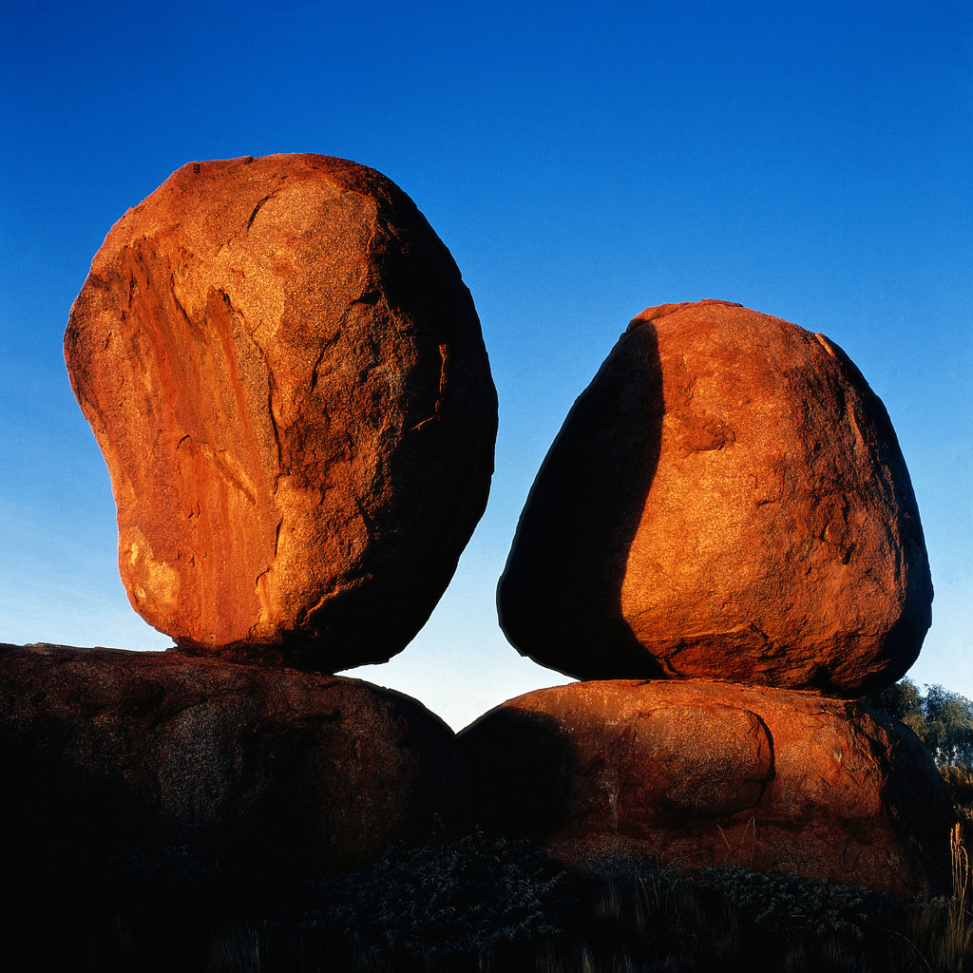
Where? Find Friends, Co-Workers and maneuver through Buildings
Android Wear Hackathon Google Extended I/O Zurich 2014 Matthias Thoma Florian Antonescu
G

Slide 2
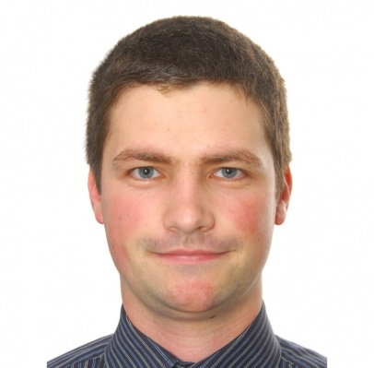
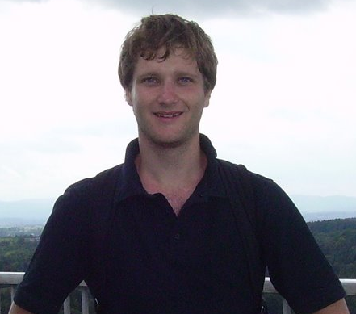
Team
Florian Antonescu
Matthias Thoma
Where we are from ?
SAP Research
PhD@University of Bern
What are we doing?
- Playing and fiddling with new ideas and technologies
- Cloud, Mobile and Internet of Things

Slide 3
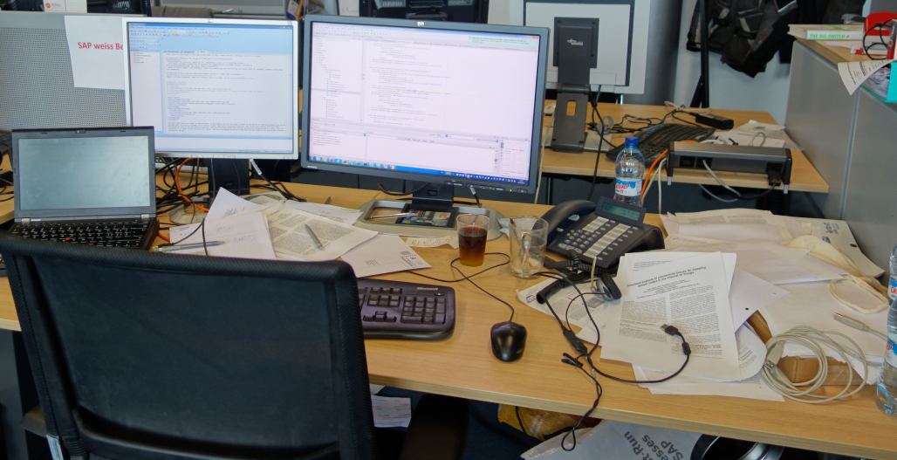

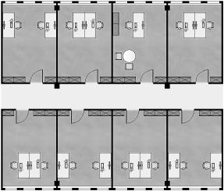
In the office?

Slide 4
In the office?
Where is my hard working colleague Matthias Thoma?

Slide 5
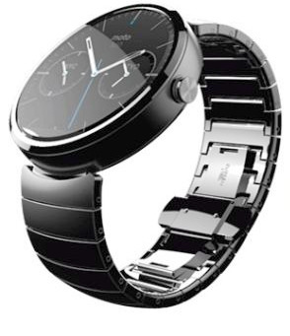
In the office?
Where is Matthias Thoma?

Slide 6
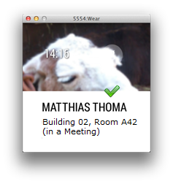
In the office?
In the office!

Slide 7
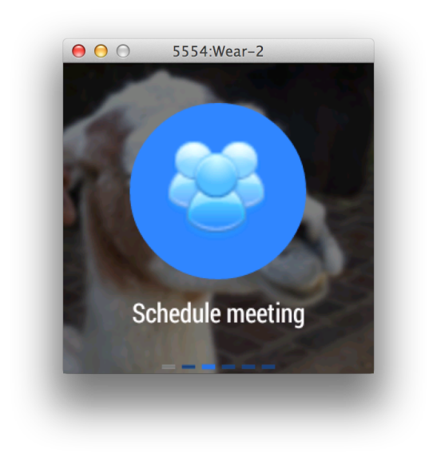
In the office?
In the office!

Slide 8
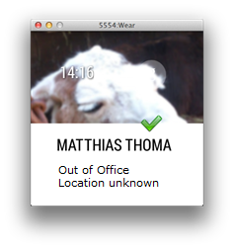
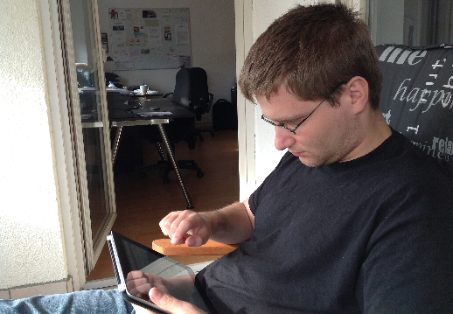
In the office?
Hiding at home!
Geo- fencing

Slide 9
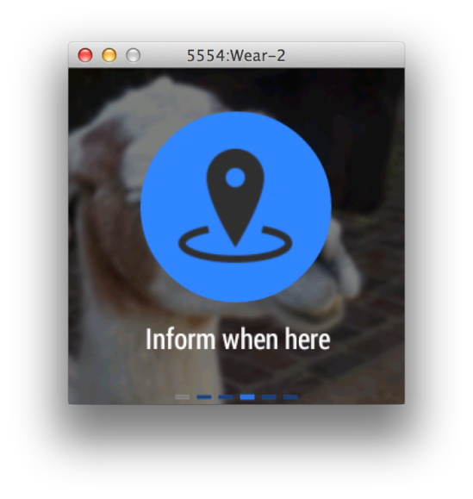
In the office?
Hiding at home!
Geo- fencing

Slide 10
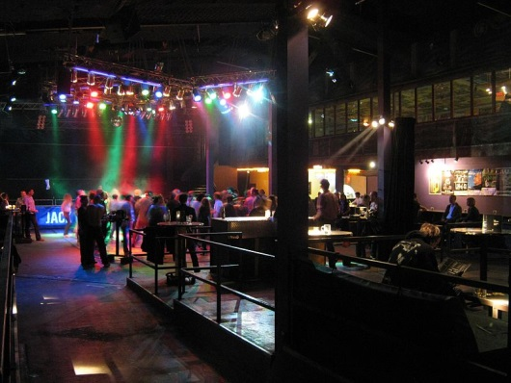
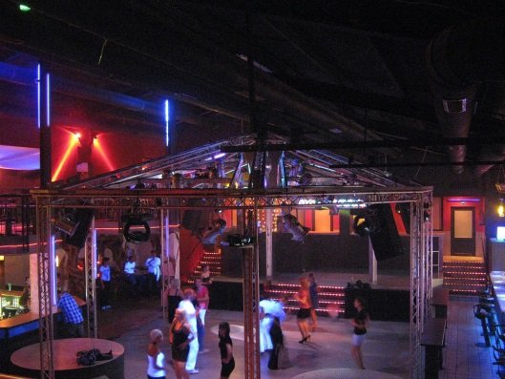
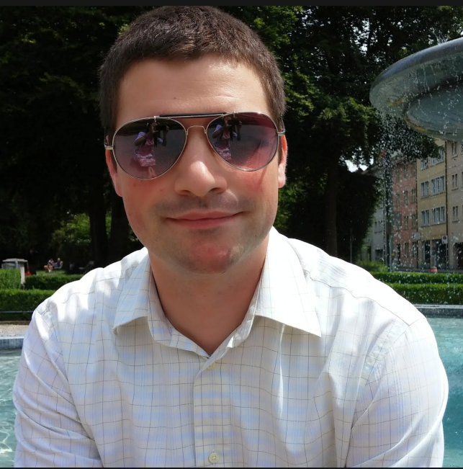
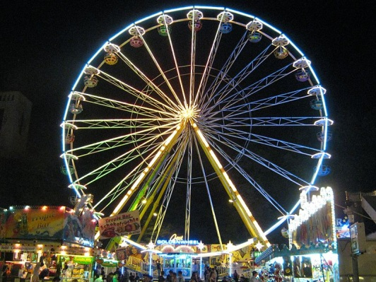
After work
Where is that party-goer Matthias Thoma?

Slide 11
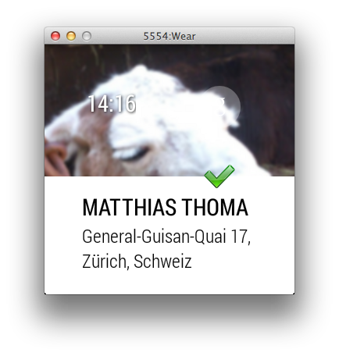
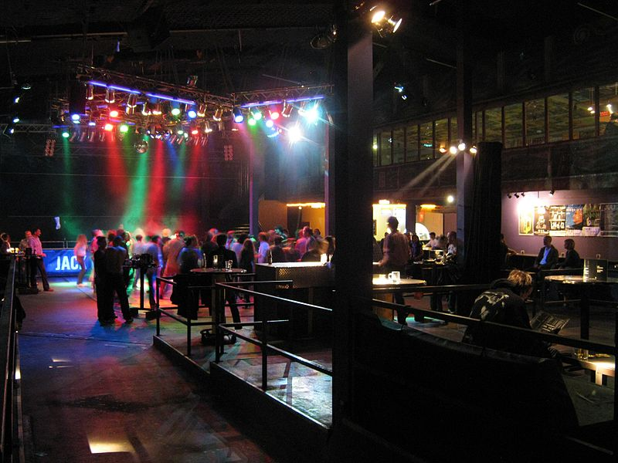
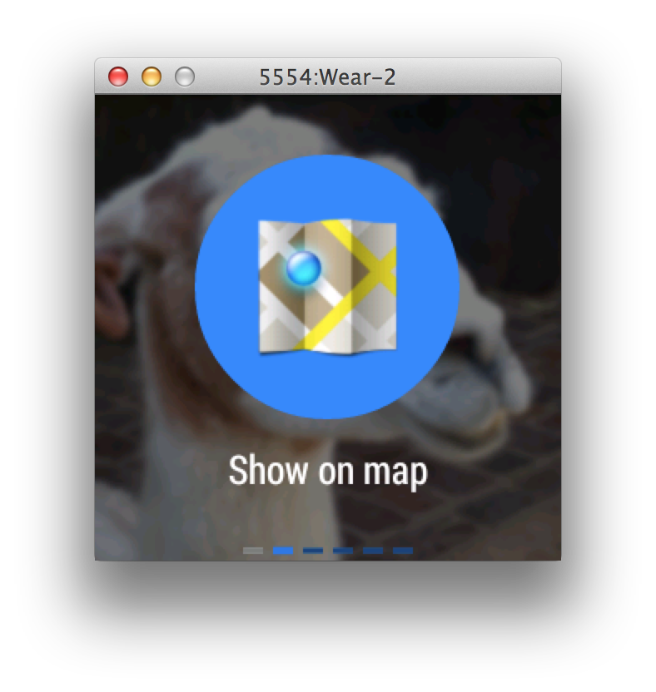
After work

Slide 12
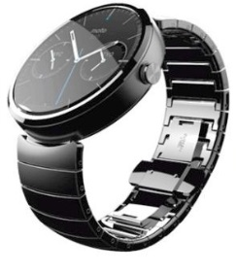
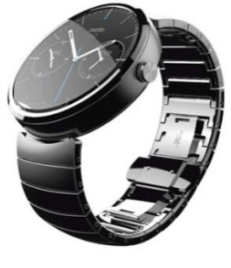
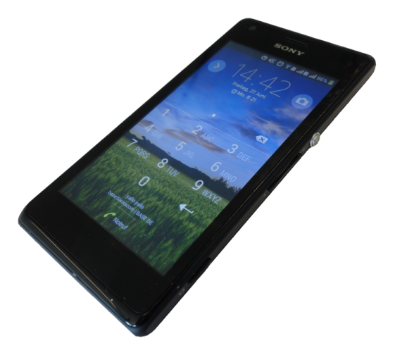
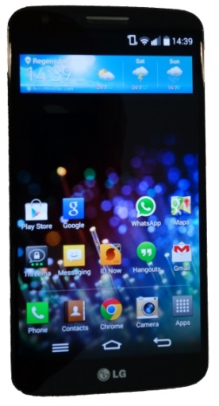
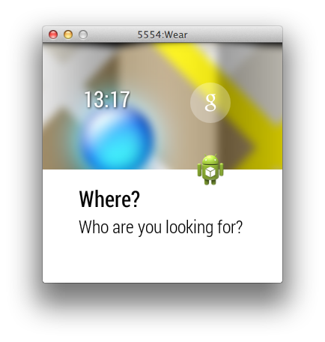
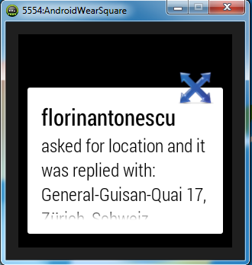

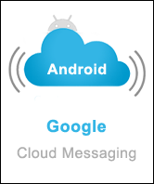
It is a Hackathon! (Demo time)

Slide 13
End
Moto 360 Image:
Chris F
http://commons.wikimedia.org/wiki/File:Moto_360_smartwatch.jpg
CC BY 2.0

